Slide 1

Web Application Development
How Web Works?
Basics of C# Programming
Dot Net Core (C#)
By Ebad Majeed

Slide 2
Web Application Development
You should be able to employ various technologies underlying “World Wide Web” to develop interactive, dynamic, database driven web applications.
Client Side Development
HTML
Cascading Style Sheets (CSS)
JavaScript
Server Side Development
PHP/ASP/Python/Node.js
MySQL/SQL Server

Slide 3
The Internet
The Internet is a network of networks that uses the standard Internet Protocol Suite (TCP/IP) to serve billions of users worldwide.
Wikipedia: http://en.wikipedia.org/wiki/Internet

Slide 4
Internet Protocol (IP)
Principle protocol for attempting to send data between two computers.
Each device has an IP address.

Slide 5
Internet Protocol (Cont’d)
The first major version of IP, now referred to as Internet Protocol Version 4 (IPv4) is the dominant protocol of the Internet, although the successor, Internet Protocol Version 6 (IPv6) is in active, growing deployment worldwide.
While IPv4 allows 32 bits for an IP address, and can therefore support 2³² (4,294,967,296) addresses, IPv6 uses 128‐bit addresses, so the new address space supports 2¹²⁸ (approximately 340 undecillion or 3.4×10³⁸) addresses.
You can find your local IP address using “ipconfig” on Windows.

Slide 6
Transmission Control Protocol (TCP)
The Transmission Control Protocol (TCP) is one of the core protocols of the Internet Protocol Suite.
Adds multiplexing
Multiplexing: multiple programs using the same IP address.
Examples: FTP (21), SMTP (25) and HTTP (80).
List of TCP Port Numbers
Some programs (games, streaming media programs) use simpler UDP protocol instead of TCP.
Wikipedia: http://en.wikipedia.org/wiki/Tcp_protocol
Notes:
FTP: File Transfer Protocol
HTTP: Hypertext Transfer Protocol
SMTP: Simple Mail Transfer Protocol

Slide 7
Domain Name Servers (DNS)
Set of servers that translate names to IP addresses.
Example: www.google.com → 216.58.212.196
If it has changed, then go to terminal and type:
nslookup www.google.com
and it will give you the IP address)

Slide 8
World Wide Web
World Wide Web ≠ The Internet
The Internet is a hardware and software infrastructure that provides connectivity between computers.
In contrast, World Wide Web is one of the services that run on the Internet.

Slide 9
How does Web Work?
Information is stored in documents called Web pages.
Web pages are files stored on computers called Web servers.
Computers/Devices reading the Web pages are called Web clients.
Web clients view the pages with a program called a Web browser.

Slide 10
Web Server
Computer running web server software that listens for web page requests on TCP port 80
Popular web server software:
Apache
Apache Tomcat
XAMPP
Microsoft Internet Information Server (IIS)

Slide 11
Web Browser
Software application that displays web pages
Popular Web Browsers:
Mozilla Firefox
Microsoft Internet Explorer (IE): part of Windows
Apple Safari: part of Mac OS
Opera
Google Chrome

Slide 12
Hypertext Transport Protocol (HTTP)
HTTP is the foundation of data communication for the World Wide Web.
HTTP functions as a request‐response protocol in the client-server computing model.

Slide 13
HTTP Error Codes
The web server returns a special "error code“ number to the browser, possibly followed by an HTML document
Common Status Codes:
200 OK
301 Page has moved
403 You are forbidden to access this page
404 Page not found
500 Internal server error

Slide 14
Uniform Resource Locator (URL)
Uniform Resource Locator (URL) is an identifier for the location of a resource on the Internet.
Basic URL:
http://www.Westminster.ac.uk/Campus/Cavendish/Faculty
Upon entering this URL into the browser, it would:
ask the DNS server for the IP address of www.Westminster.ac.uk
connect to that IP address at port 80
ask the server to GET / Campus/Cavendish/Faculty
display the resulting page on the screen

Slide 15
Client Server Request/Response

Slide 16
Benefits
Global Access
24 Hour Access
Cross Platform
Easy to Use
Easy to Publish & Update
Distributed
Multimedia Capable

Slide 17
Limitations
Easy to get Lost
Reading on a Computer
Limited Attention Span
User altered Pages
User Hardware & Software Limitation
Security
Bandwidth

Slide 18
Static Web Page
Static Content
Content is added by Publisher
User can consume all content in a single visit

Slide 19
Web Application
Dynamic Content
Content is added by Users
User can use it numerous times

Slide 20
Complexity of Web Based Systems
Document Centric
Static Websites
Interactive / Transactional
Travel Planning, Online Banking, Shopping
Workflow Management
e‐Government , B2B
Collaborative / Portal Oriented
Chatrooms, Forums, Community Portal, Business Portal
Ubiquitous
Location Aware, Multi‐Platform Delivery
Social Web
User content, Blogs, etc.
Semantic Web
Syndication, Knowledge Management

Slide 21
Basics of C# Programming
C# (pronounced "C sharp") is a modern, versatile programming language developed by Microsoft.
Part of the .NET framework, C# is widely used for building various applications, including web and desktop applications.

Slide 22
C# Syntax and Structure
C# Basics:
Every C# program has a basic structure, starting with a Main method.
The syntax is designed to be clear and readable, following conventions such as semicolons at the end of statements.
Data Types and Variables:
C# supports various data types (int, float, string, etc.).
Variables store data, and their types must be declared.
Basic Operations:
Overview of basic arithmetic operations and string concatenation in C# is same as python.

Slide 23
Control Structures
Conditional Statements (if, else):
Using if and else statements to make decisions in code based on conditions.
if(n == 0) {Console.WriteLine(“something”)} else {Console.WriteLine(“do something else”)}
Loops (for, while):
for (int i=0;i<10;i++) {…}
while (True) {…}
Switch Statements:
same as in python, scope is defined by {…}

Slide 24
Functions and Methods
Functions:
Functions are blocks of code that perform a specific task.
They enhance code organization and maintainability.
Function Declaration:
public void funcName() {…}
parameters and return type same as python but try to understand return type in C#
Calling Functions:
funcName();

Slide 25
Object-Oriented Programming (OOP) in C#
Classes and Objects:
Classes act as blueprints for objects.
Instances of classes are objects, each with its own state and behavior.
Inheritance:
Classes can inherit properties and behaviors from other classes.
Have you inherited anything from your parents?

Slide 26
Object-Oriented Programming (OOP) in C#
Polymorphism:
Objects can take on multiple forms.
Methods can be overridden.
Encapsulation:
Involves bundling data and methods that operate on the data.
Benefits of encapsulation are code organization and security.
Abstraction:
Hiding complex details and exposing only essential features.
Make Coffee example

Slide 27
Introduction
ASP stands for Active Server Pages
ASP is a development framework for building web pages.
Some developers prefer ASP Dot NET because:
It is Open Source
An easy server side web application framework
Has Continuous support from Microsoft

Slide 28
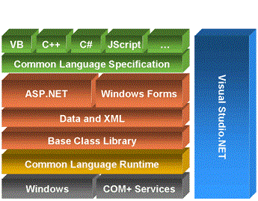
Dot NET Architectural Hierarchy
CLS
FCS
IDE
CLR
Notes:
CLS: Common Language Specification
FCS: Framework Class Library/Specification
CLR: Common Language Runtime

Slide 29
Components of Dot NET Framework
Common Language Specification (CLS)
.Net Framework provides CLS to ensure that your code is accessible to developers who are using other .Net programming languages i.e. VB, VC++ etc.
In this way, CLS enables languages interoperability which means that a “dll (data link library)” developed in one .Net language can be accessed from another .Net language.

Slide 30
Components of Dot NET Framework
Framework Class Library/Specification (FCL/FCS)
Collection of classes and data types that enables .Net application to read/write files, accessing database, process XML, display graphical user interface, draw graphics, enable using web services and so on.
Base class library is core of FCL and provides the most fundamental functionality, which includes classes in namespaces System e.g. System.IO (used for filing), System.Collections (used for utilizing different data structures i.e. stack, list, hashtable etc).

Slide 31
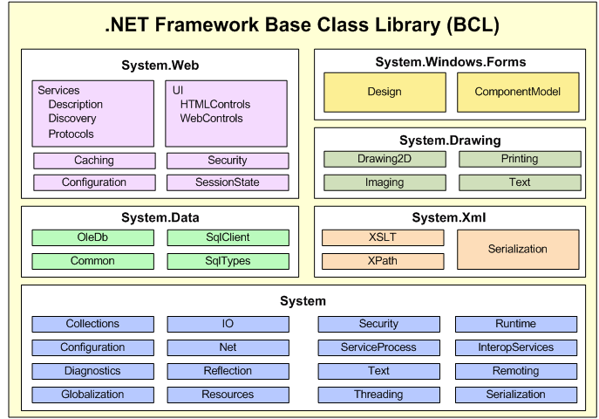
Components of Dot NET Framework
Base Class Library

Slide 32
Components of Dot NET Framework
Common Language Runtime
It is Execution Engine for .Net application
It serves as an interface between .Net application and operating system
It also provides other services such as
Loads and execute code
Conversion of intermediate language to native machine language
Manage memory

Slide 33
Features of Dot NET Platform
Multilanguage Development
CLR provides support for multiple languages
Therefore, it is not required to develop the libraries that are already programed in other .Net languages because CLR allow the reuse of class library in any .Net language once it is programmed in particular .Net language.

Slide 34
Features of Dot NET Platform
Platform and Processor Independent
Once managed (.Net framework based) application is developed, it can be executed on any platform (H/W & S/W) that supports CLR.

Slide 35
Features of Dot NET Platform
Memory Management
.Net provides various mechanisms to avoid memory leaks from application. A commonly followed technique is:
Garbage Collection, which is automatic memory management approach for .Net applications.

Slide 36
Features of Dot NET Platform
Security
The common language runtime and the .NET provide many useful classes and services that enable developers to easily write secure code and enable system administrators to customize the permissions granted to code so that it can access protected resources. In addition, the runtime and the .NET provide useful classes and services that facilitate the use of cryptography and role-based security.
Interoperability
The ability of one language components/dll/classes to be used in application that is developed in another .Net based language.
It decreases development efforts by reusing existing code stuff.

Slide 37
ASP Development Models
ASP supports many different development models:
Classic ASP
ASP.NET Web Forms
ASP.NET MVC
ASP.NET Web Pages
ASP.NET API
ASP.NET Core

Slide 38
Classic ASP - Active Server Pages
ASP (aka Classic ASP) was introduced in 1998 as Microsoft's first server side scripting language.
Classic ASP pages have the file extension .asp and are normally written in VBScript.

Slide 39
ASP.NET
ASP.NET was released in 2002 as a successor to Classic ASP.
ASP.NET pages have the extension .aspx and are normally written in C# (C sharp).
ASP.NET 4.6 is the latest official version of ASP.NET.
ASP.NET 5 was expected to be an important redesign of ASP.NET.
However, the development of ASP.NET 5 was stopped in favor of ASP.NET Core.

Slide 40
ASP.NET Web Pages
ASP.NET Web Pages is an SPA application model (Single Page Application).
The SPA model is quite similar to PHP and Classic ASP.
ASP.NET Web Pages is being merged into the new ASP.NET Core.

Slide 41
ASP.NET MVC
ASP.NET MVC is an MVC application model (Model-View-Controller).
ASP.NET MVC is being merged into the new ASP.NET Core.

Slide 42
ASP.NET API
ASP.NET API is an API application model (Application Programming Interface).
ASP.NET API is being merged into the new ASP.NET Core.

Slide 43
ASP.NET Web Forms
ASP.NET Web Forms is an event driven application model.
ASP.NET Web Forms is not a part of the new ASP.NET Core.

Slide 44
ASP.NET Core
ASP.NET Core was released in 2016.
ASP.NET Core merges ASP.NET MVC, ASP.NET Web API, and ASP.NET Web Pages into one application framework.

Slide 45
